Slide 1
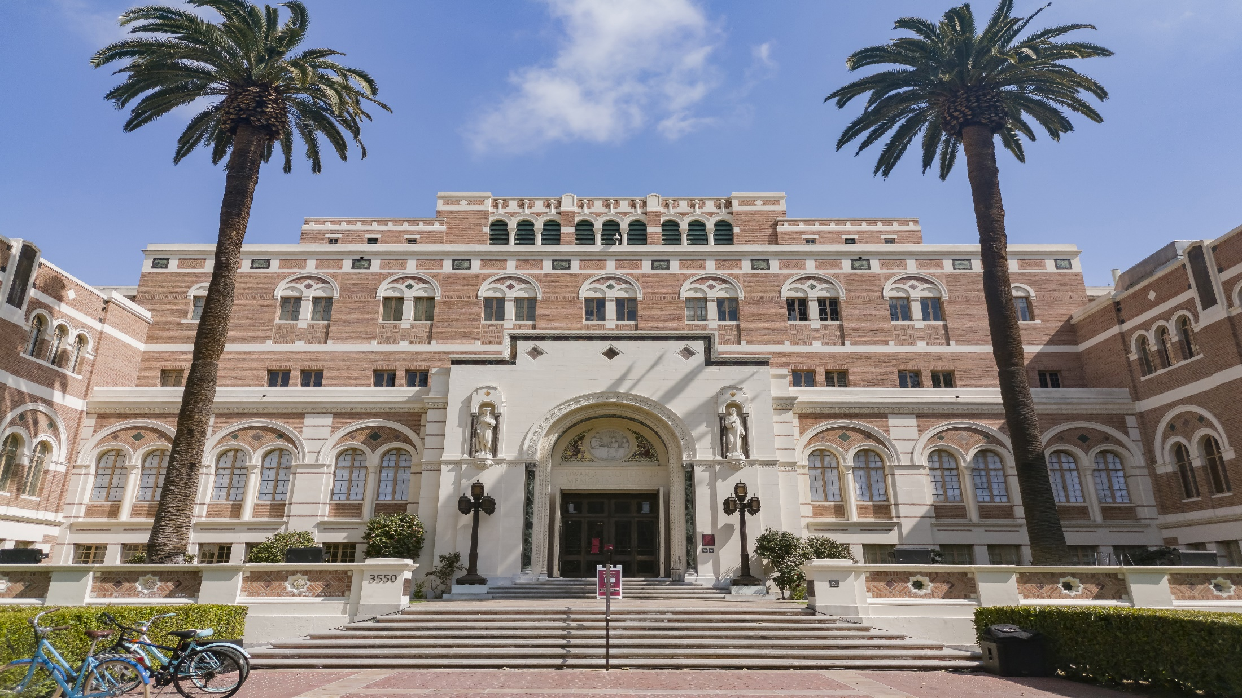
Summary of NSF PAPPG 24-1 Changes
May 17, 2024

Slide 2
contents
WHAT IS THE PAPPG?
APPLICABILITY OF THE PAPPG
WHEN IS THE NEW PAPPG EFFECTIVE?
CHANGES IN THE NEW PAPPG
WHO TO CONTACT WITH QUESTIONS
1
2
3
4
5

Slide 3
WHAT IS the proposal and award policies and procedures guide (PAPPG)
The NSF PAPPG stands for the "National Science Foundation Proposal and Award Policies and Procedures Guide." It's essentially a comprehensive manual outlining the policies, procedures, and guidelines for preparing and submitting proposals to the National Science Foundation (NSF) for funding scientific research, education, and related activities. The PAPPG serves as a vital resource for researchers, institutions, and NSF staff involved in the grant application and award process, ensuring consistency, transparency, and accountability in the NSF's funding mechanisms.
You can locate the PAPPG : https://new.nsf.gov/policies/pappg

Slide 4
Applicability of the pappg
The NSF periodically updates the PAPPG to reflect changes in policies, procedures, and guidelines. Depending on when your proposal was submitted or when your award was received, different iterations of the PAPPG will apply. It's crucial for researchers and institutions to stay informed about the latest versions of the NSF PAPPG to ensure compliance with current requirements and procedures.

Slide 5
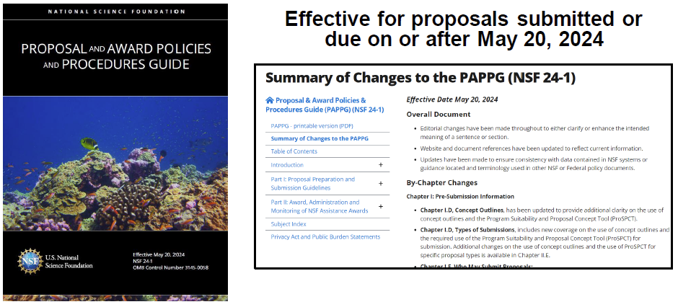
When is PAPPG (NSF 24-01) Effective

Slide 6
Changes To the New pappg (NSF 24-01)

Slide 7
WHEN TO SUBMIT PROPOSALS
Submitter’s local time clarified to mean 5:00 PM Submitting Organizations time. This is regardless of the PI’s location at the time of submission.
In the event of a collaborative proposal where multiple parties are submitting the deadline time is 5 pm local for each organization submitting.

Slide 8
Foreign organization eligibility
Revision clarifies that the following must be included in the justification when including a foreign organization or foreign individual’s involvement in NSF budget (via a subaward or consultant arrangement).
• Why support from the foreign counterpart’s in-country resources is not feasible;
• Why the foreign organization or foreign individual can carry out the activity more effectively than a U.S. organization or U.S. individual;
• What unique expertise, organizational capability, facilities, data resources, and/or access to a geographic location not generally available to U.S. investigators the foreign organization or foreign individual brings to the project; and
• What significant science and engineering education, training, or research opportunities the foreign organization or foreign individual offers to the U.S. Such information must be included in any proposal to NSF, including new and renewal proposals.
The information must be included in the project description section of the proposal. The box for "Funding of a Foreign Organization or Foreign Individual" must be checked on the Cover Sheet if the proposal includes funding for a foreign organization or foreign individual.

Slide 9
Malign foreign talent recruitment programs
A Malign Foreign Talent Recruitment Program (MFTRP) is defined as any initiative or endeavor that involves offering compensation, benefits, or opportunities by a foreign entity or its affiliates in exchange for actions such as unauthorized transfer of intellectual property, recruitment of trainees or researchers, employment or appointments violating standard terms of Federal awards, and imposing restrictions hindering research capacity or obligating engagement in duplicative work. Such programs are sponsored by foreign countries of concern, entities based in those countries, or designated foreign talent recruitment programs.
Countries of Concern currently include: China, Iran, North Korea and Russia
In accordance with Section 10632 of the CHIPS and Science Act of 2022 (42 U.S.C. § 19232)
For full definition please see the PAPPG Introduction, Definitions section D

Slide 10
Malign foreign talent recruitment programs
Changes in the new guide include:
Any Individual who is a current party of a MFTRP is ineligible to serve as a senior/key person on an NSF proposal or award.
Each senior/key person must certify in the Biographical Sketch and Current and Pending prior to proposal submission that they are not part of a MFTRP.
Organizations must certify upon proposal submission that all senior/key personnel have been made aware of and are not a party to an MFTRP
Each PI and co-PI on any NSF award must certify annually thereafter in their annual progress report.
A new term will be added to NSF agreements implementing this term.

Slide 11
Post award foreign financial disclosure report
USC will now be required to submit an annual report to NSF reporting any gift or contract with a cumulative value of $50K or more from a country of concern.
These reports will be handled by USC’s Office of Culture, Ethics and Compliance and will be due on the 31st of each calendar year in Research.Gov.
USC will be required to maintain relevant records including contracts, agreements, or documentation of financial transitions associated with any such gift or contracts.
A new term will be added to NSF awards implementing this requirement

Slide 12
What are the common forms
The National Science and Technology Council (NSTC) Research Security Subcommittee has worked to develop consistent disclosure requirements for use by senior personnel, as well as to develop common disclosure forms for the Biographical Sketch and Current and Pending (Other) Support sections of an application. NSF has agreed to serve as steward for these common forms.
NSF provides the following clarification/deviation on these form for NSF submissions:

Slide 13
Changes to the Biographical sketch
Continue to use SciENcv: Science Experts Network Curriculum Vitae tool to develop biosketches. It has been updated to address the new requirements.
No page limitation
Added required Certification that Key Personnel are not part of a Malign foreign talent recruitment programs
Removed Synergistic Activities and now requires this to be uploaded as a separate 1 page document as part of the Senior Key Personnel documents at proposal stage. It should include a list of up to five distinct examples that demonstrates the broader impact of the individual’s professional and scholarly activities.
For instructions and additional Information please visit The Biographical Sketch Common Form.

Slide 14
Changes to the Current and pending (other) support
Continue to use SciENcv: Science Experts Network Curriculum Vitae tool to develop Current and Pending. It has been updated to address the new requirements.
Added required certification that Key Personnel are not part of a Malign foreign talent recruitment programs
For instructions and additional Information please visit Current and Pending (Other Support) Common Form.

Slide 15
Mentoring plan for graduate students
Funding proposals for graduate students and/or postdoctoral scholars must include a mentoring plan.
Mentoring plan shall not to exceed one page.
There are not separate plans for graduate students and postdoctoral scholars.
A single plan must be included for all graduate students or postdoctoral researchers supported by the project regardless of whether they reside at the submitting organization, any subrecipient organization, or at any organization participating in a simultaneously submitted collaborative proposal.

Slide 16
Individual development plans for graduate students and post docs
For each NSF award that provides substantial support to postdoctoral scholars and graduate students, each individual must have an Individual Development Plan, which is updated annually, that maps the educational goals, career exploration, and professional development of the individual.
NSF defines “substantial support” as an individual that has received one person month or more during the annual reporting period.
These plans are not submitted to NSF, however the PI must retain these records and certify annually through the Progress Report that the plans are in place.

Slide 17
Post award addition of graduate students and post docs
Mentoring Plan:
If the original proposal included a mentoring plan then no further documentation is needed. If not, the PI needs to submit one to the NSF Program Officer. Please CC’ your DCG Officer on the submission so we will have a record of the submission.
Individual Development Plan:
An Individual Development Plan will need to be created for each new post doc and graduate student and the PI will be required to certify to compliance with this requirement annually as part of the progress report. These do not need to be provided to NSF but documentation should be kept by the PI.

Slide 18
Transfer of an award with grad students and post docs
If the transfer includes funding post docs and grad students, then the request must include a mentoring plan. The plan must be uploaded under “Mentoring Plan” in the Supplementary Documentation section of Research.gov.

Slide 19
Proposals that impact Tribal nations
Chapter II.E.10, Seeking and Obtaining Tribal Nation Approval for Proposals that May Impact Tribal Resources or Interests, has been added as a new section to the Proposal.
If a proposed scope of work will impact tribal resources, land, language, subsistence rights, life or interests of tribal nation then the written approval of the impacted tribal nation must be included
To indicate applicability, please check the cover sheet “potential impacts to tribal nations” and upload the written approval under Supplementary Documents.
Applicable projects that do not have prior written approval from the official(s) designated by the relevant Tribal Nation(s) will not be awarded by NSF.

Slide 20
Postaward addition of safe and inclusive working environments
If USC rebudgets funds or receives supplementary funding to support off-campus or off-site research and a Plan for Safe and Inclusive Working Environments was already developed and included in the original proposal, then no further documentation is necessary. If not, then such a plan must be created and kept on file at USC.
In the event the addition of a plan is required please notify your DCG officer and provide the plan to DCG to be kept on file with the award .

Slide 21
Revised definition of scientific integrity
New definition for scientific integrity derived from "A Framework for Federal Scientific Integrity Policy and Practice" issued by the National Science and Technology Council.
Scientific integrity is the adherence to professional practices, ethical behavior, and the principles of honesty and objectivity when conducting, managing, using the results of, and communicating about science and scientific activities. Inclusivity, transparency, and protection from inappropriate influence are hallmarks of scientific integrity.

Slide 22
Up to date sam.gov and uei registration
New guide clarifies and reinforces requirements for proposers to have an active and valid UEI and SAM Registration.
NSF will block any award approval actions if SAM and UEI are not valid.
NSF does not have control over SAM system registration.
USC is currently active and registered in SAM and has a valid UEI.

Slide 23
Updates to “nsf policy on sexual harassment, other forms of harassment, or sexual assault
Updates to clarify the following:
AOR of the institution is required to notify NSF of any violation within 10 days of finding/determination or placement of PI on admin leave or imposition of an admin action. Please promptly notify DCG if you become aware of any violation. DCG will coordinate with the school, OCEC and the sponsor to ensure compliance.
Minor edits to what qualifies as what violations are required to be reported.
Updates to information that must be reported to NSF in the event of a violation.
Reminder that if a PI or Co-PI will be disengaged from the project for greater than 3 months prior approval of the sponsor is required, and an interim PI might need to be appointed. Please contact your DCG officer if this is the case, and your officer can assist with next steps.

Slide 24
Addition to environmental justice under e.0. 14096
In addition to statutory prohibitions, several civil rights and equal opportunity-related Presidential Executive Orders require compliance by NSF recipients. E. O.14096 “Revitalizing Our Nation's Commitment to Environmental Justice for All” was issued April 21, 2023. This E.O. which directs Federal agencies to make achieving environmental justice part of the agency mission.
This new E.O. has been incorporated into the PAPPG in the following sections:
Chapter XI.A, Non-Discrimination Statutes and Regulations incorporates requirement to comply with Executive Order 14096, "Revitalizing Our Nation's Commitment to Environmental Justice for All;"
Chapter XI.A.8, Environmental Justice under E.O. 14096, has been added as a new section regarding NSF's implementation of Executive Order 14096, "Environmental Justice” which directs Federal agencies to make achieving environmental justice part of the agency mission.

Slide 25
Concept Outlines
Concept Outlines are used for Planning, RAPID, EAGER and RAISE proposals. The funding opportunities may require submission of a concept outline prior to submission of a full proposal.
The new guide provides revised guidance as follows:
Revised Definition of a Concept Outline ~ A concept outline is a concise summary of a project idea that contains a title, the proposed proposal type, information about the prospective PI(s), potentially germane NSF organizational unit(s), keywords, a brief narrative description of the idea, and a brief description of how the idea fits the proposed proposal type or funding opportunity. The narrative description of the idea may outline the goals and general approaches of the project, anticipated uses of funding, and how the work satisfies the NSB-approved Intellectual Merit and Broader Impacts criteria.
Voluntary Submissions ~ The guide now clarifies that the prospective PI will receive feedback by email or follow-up discussion with a cognizant NSF program officer, however, a “Program Officer Concurrence Email” is not typically provided.

Slide 26
Other minor changes
Chapter II.C.2, Proposal Font, Spacing, and Margin Requirements, has been modified to allow for submission of proposal documents in landscape format.
Chapter II.E.7, Projects Requiring Advanced Computing, Data, and Analysis Capabilities, has been updated with revised instructions for how to apply for such resources for projects that require such resources.
Chapter VI.E, Supplemental Support, has been modified to reflect that NSF Dear Colleague Letters and solicitations may identify supplemental funding opportunities with specified durations longer than six months and for additional funding amounts.
Chapter XI.A.7, Limited English Proficiency under E.O. 13166, has incorporated additional language regarding Limited English Proficiency under Executive Order 13166. Requires government agencies to take steps to provide meaningful access to its programs and activities to members of the public who are limited in their English proficiency, including recipients’ programs and activities.

Slide 27
Questions ?
Your DCG Officer
DCG Directory
DCG Office Hours via Zoom: https://usc.zoom.us/j/98233041088
Wednesdays: 9-10 a.m.

